Slide 1
TCSS 558A Final Project
A Distributed Geospatial Sensor Networks
Jiacheng, Liu
Pinghan, Lei

Slide 2
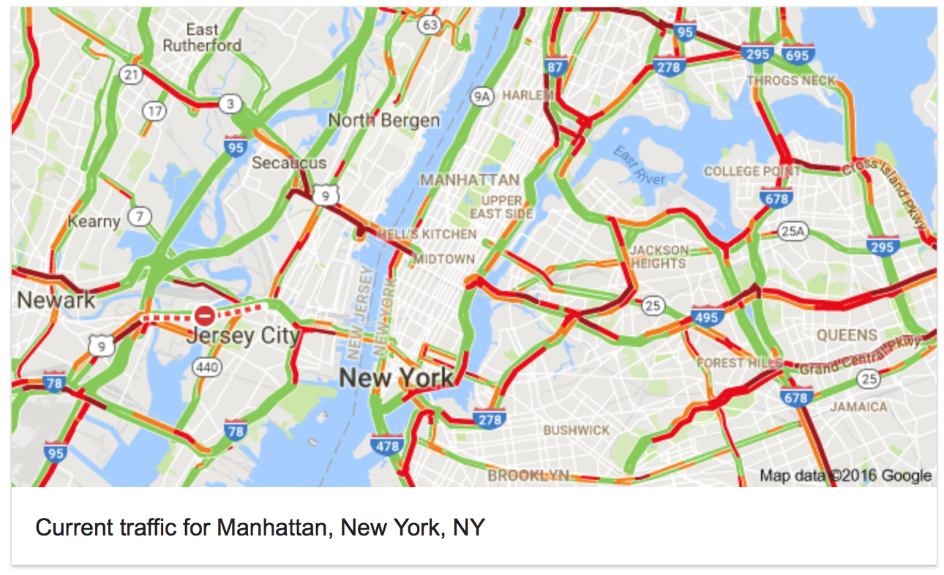
Introduction

Slide 3
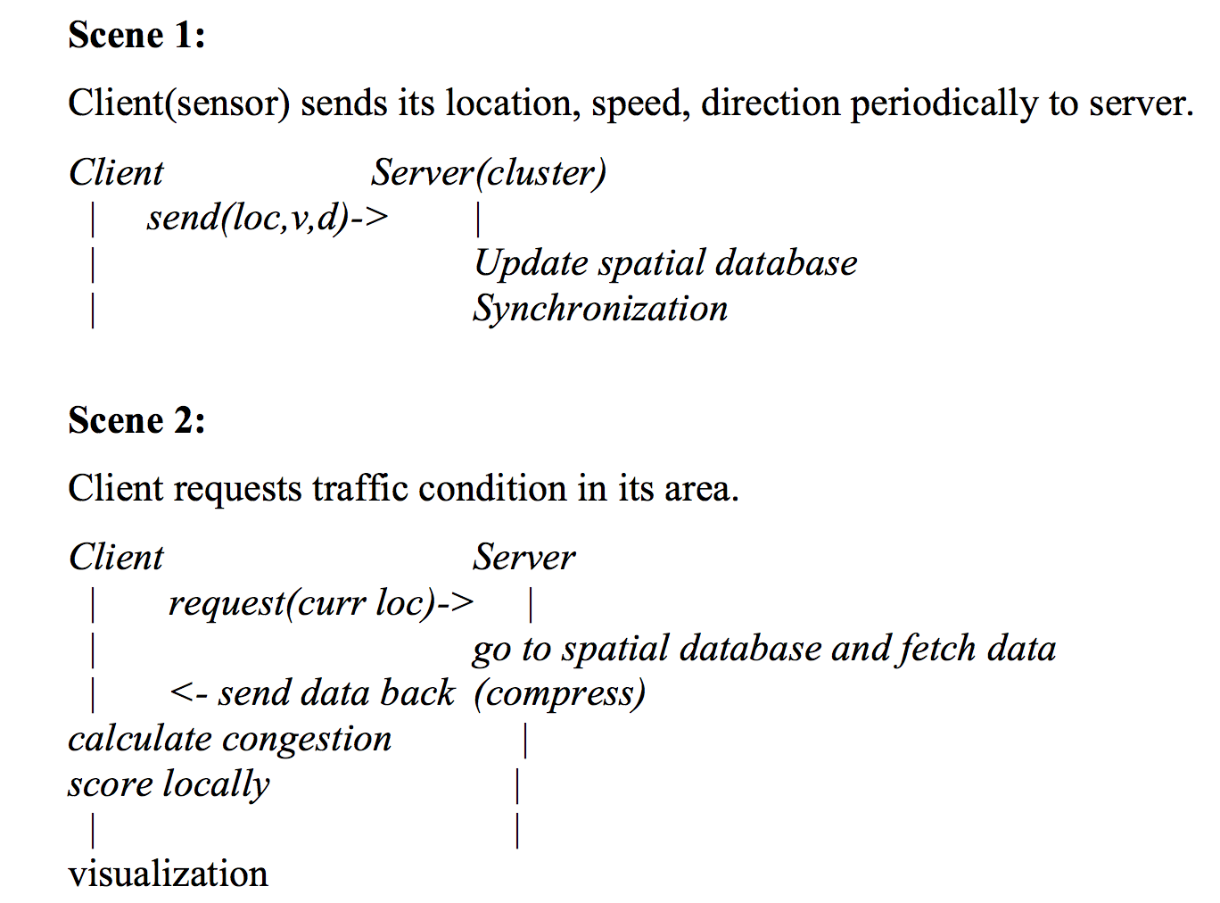
Use Cases

Slide 4
Architecture
Clients
Cluster (servers)
Sensors
RPC
Database Synchronization
(N replicas, based on previous projects)
Requests
RPC
Geodpatial
Database
JSON
Visualization

Slide 5
Geospatial Database
100% Designed and Implemented by ourselves
Divde map into grids i.e. 200*200
No R trees, Quad trees …
Hash coordinates!
Key-value store!

Slide 6
Data Synthesis
Grids
Generate paths using landmarks
47.625556 N
Capitol Hill,
Seattle
47.6183333 N
122.312425 W
122.3273611 W

Slide 7
Data Structure
Client
[UserID, Longitude, Latitude]
Server
Json file contains all the location information along with the calculated weight of every location.

Slide 8
UI
Visualization through Google Map Javascript API
Heat Map shows the density of users in certain area
Setting dissipating to ‘true’, making the range of heat would automatically adjust with zoom in or out on Google Map

Slide 9
Demo Settings
50 ‘clients’ , each 40+ steps
3 ‘servers’
Map: Capitol Hill, Seattle
Techniques involved:
python
python xmlrpc library
python socket
Javascript and Google Map API

Slide 10
Demo

Slide 11
Acknowledgement
Tools
Jiacheng Liu
Servers
Geospatial Database
Data
Pinghan Lei
Servers
Clients
Visualization
Python XML RPC Library https://docs.python.org/2/library/xmlrpclib.html
Google Map Javascript API https://developers.google.com/maps/documentation
/javascript/
Demo Website: JS Bin http://jsbin.com/

Slide 12
Reference
Google Map Javascript API
https://developers.google.com/maps/documentation/javascript/
Python XML RPC
https://docs.python.org/2/library/xmlrpclib.html
Python Cookbook
David Beazley, Brian K. Jones, 05.10.2013, O'Reilly Media, Inc.
Kuro’s Blog
http://kuro.tw/posts/2015/04/29/a-brief-talk-on-google-map-heat-map-api/

Slide 13
Thanks for Listening !

